Slide 1
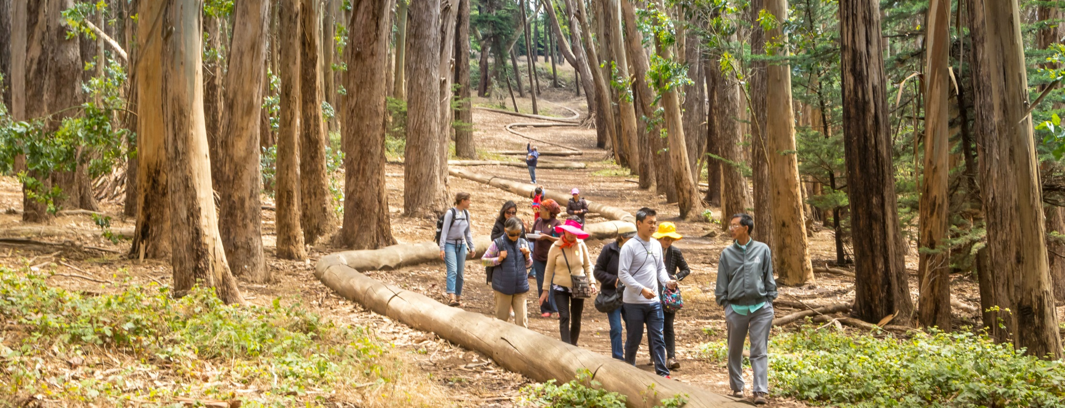
The Power of Park Prescriptions
Building on a National Movement
Notes:
Photo cred: Kirke Wrench, NPS

Slide 2
Agenda
Introduction
Why Parks and Health?
What are Park Prescriptions?
Park Prescription Models
Measuring Impact

Slide 3
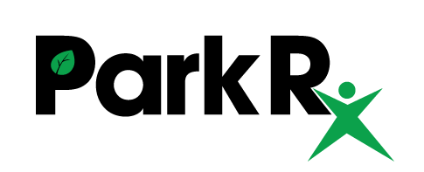
Notes:
Many agencies have been looking at parks as a low-cost resource for preventative health care since 2011. [Your agency] has focused on building and supporting partnerships between park, health, and community agencies, as well as identifying best practice and building tools and models to support the growth and adoption of programs at the intersection of health and parks.
The National ParkRx Initiative is a national community of practitioners advancing the use of parks and public lands to improve health and wellness among individuals and communities. These practitioners have varying models of Park Prescription programs and work together to share lessons learned and support those trying to start or improve their programs.

Slide 4
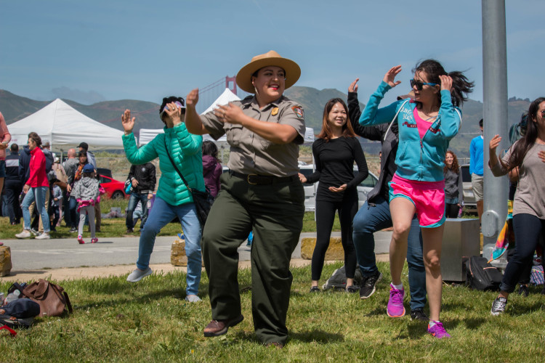
Why Parks and Health?
Notes:
Photo credit: Ryan Curran White, Parks Conservancy
In the past 6 years that we’ve been working on this issue, we’ve seen it really growing and gaining impressive momentum. In the past 2 years alone, we’ve seen the number of formal partnerships between park and health agencies more than double. So what’s all the fuss? Why is this something that we should all care about?

Slide 5
The Challenge
About half of U.S. adults have a chronic health condition
37% are obese
29 million have diabetes
7.6% suffer from depression
Burden of disease is worse for low income, communities of color
The average adult spends less than 5% of their time outdoors
Notes:
When we look at the current state of health in the United States, the outlook is pretty bleak.

Slide 6
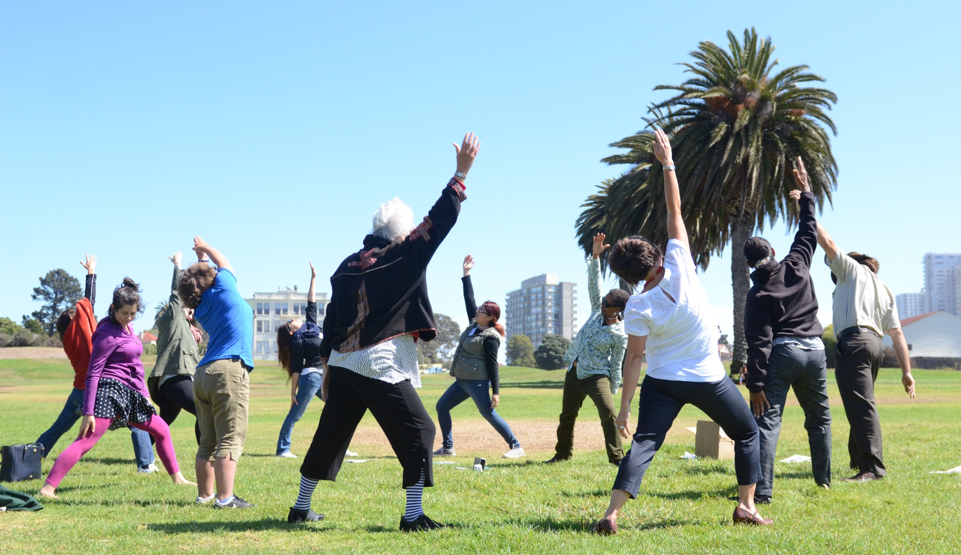
The Solution
Physical
The health benefits of nature are…
Physical activity (Cooper, 2012; Dolinsky, 2011; Cleland, 2008; Cohen, 2011)
Benefits of “green exercise” (Bowler, 2010; Thompson, 2011)
Myopia (Rose, 2008; Morgan, 2012)
Healing time (Ulirch, 1984)
Longevity (Takano, 2002)
Notes:
Photo credit: Lea Kassa, Institute at the Golden Gate
And what does nature have to do with this? I think for many of us we intuitively know and actually can feel that being outside in nature is good for us. And it turns out that research backs up this feeling! Over the past 30 years, there have been over 100 studies showing the numerous and varied health benefits of nature.
It turns out that just being outside makes you more physically active
Studies have shown that children are 2-3x more active when they’re outside (Cooper et al, 2010)
Additional studies that people who live less than 1 mile from a park have 38% more activity sessions than those living farther away
Furthermore, studies have shown reduced rates of hospitalization in children with asthma based on the number of trees in their neighborhood
And children that spend more than 3 hours outside per day have lower rates of myopia or nearsightedness (Rose, 2008; Morgan 2012)
Additional studies show that time in nature can improve various Pediatric Developmental Milestones, healing times after surgery (Ulrich, 1984), and can actually increase longevity (Takano, 2002)

Slide 7
The Solution
Mental
The health benefits of nature are…
Reduced aggression, anger, fatigue, sadness (Bowler, 2010; Kuo, 2001)
Stress, Anxiety, Depression (Sugiyama, 2008; Maas, 2009; Ulrich, 1991)
Notes:
Photo credit: Parks Conservancy
And the health benefits of nature are not just physical, there have been more and more studies over the past decade showing that time in nature actually improves our mental well-being.
Time in green space can improve emotional regulation – a systematic review of 25 studies showed that time spent exercising in green space resulted in reduced feelings of anger, aggression, fatigue, and sadness, as composed to physical activity in a built setting (Bowler, 2010)
Further studies show that rates of diagnosis for depression and anxiety are lower when there is more green space (Maas J, 2009); those living in highly green neighborhoods are 1.6x more likely to have better self-reported mental health/well-being than those living in neighborhoods with the lowest levels of greenness (Sugiyama, 2008)
And how does nature have this impact on us? Studies have shown that just 15 minutes of walking in nature reduces our pulse, blood pressure, and cortisol levels, as compared to walking in an urban or built environment.

Slide 8
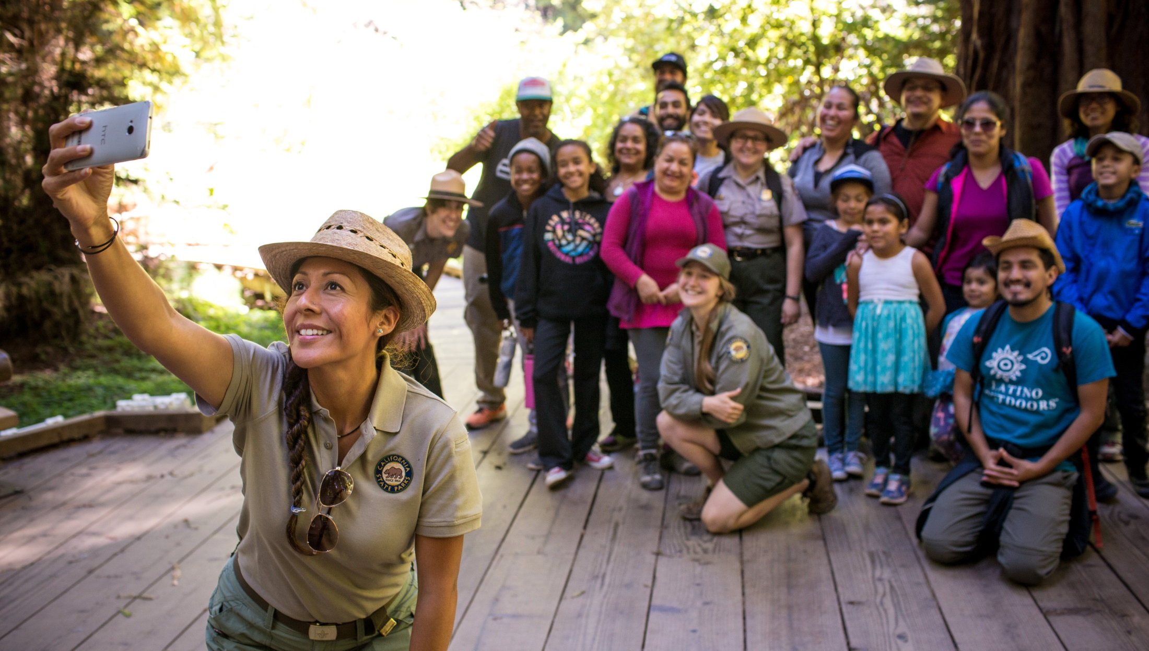
The Solution
Social
The health benefits of nature are…
Social isolation (Kweon,1998)
Sense of place (Davis, 2011)
Notes:
Photo credit: ?? Looks like it might be Cal State Parks or Latino Outdoors. I don’t know where this came from. If you have the original file name I can tell you who took it.
And these benefits that we see at the individual level are true for communities and social networks as well.
Nature promotes and creates an ideal space for building social cohesion and improve social isolation (Kweon, 1998; Davis, 2011)

Slide 9
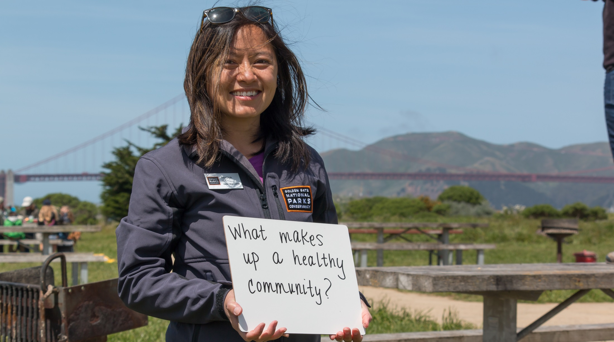
The Solution
Greater for urban, low income communities
The health benefits of nature are…
Mental wellness (Sugiyama, 2008)
Health inequality (Mitchell, 2008)
Notes:
Photo credit: Ryan Curran White, Parks Conservancy
Do you remember the study that I mentioned that showed that people that live in green communities are 1.6x more likely to have better mental health? Well it turns out that the difference between those who live in green neighborhoods versus highly brown or gray neighborhoods is even greater for people who live in poverty. (Sugiyama, 2008)
Low income communities that are exposed to the greenest environments also have lowest levels of health inequality related to income deprivation.
And yet these communities that would receive most benefit from time in nature are the very communities that have the greatest barriers to park access and are less likely to use and enjoy parks.
Mitchell R, Popham F. Effect of exposure to natural environment on health inequalities: an observational population study. Lancet 2008;372(9650):1655–60.

Slide 10
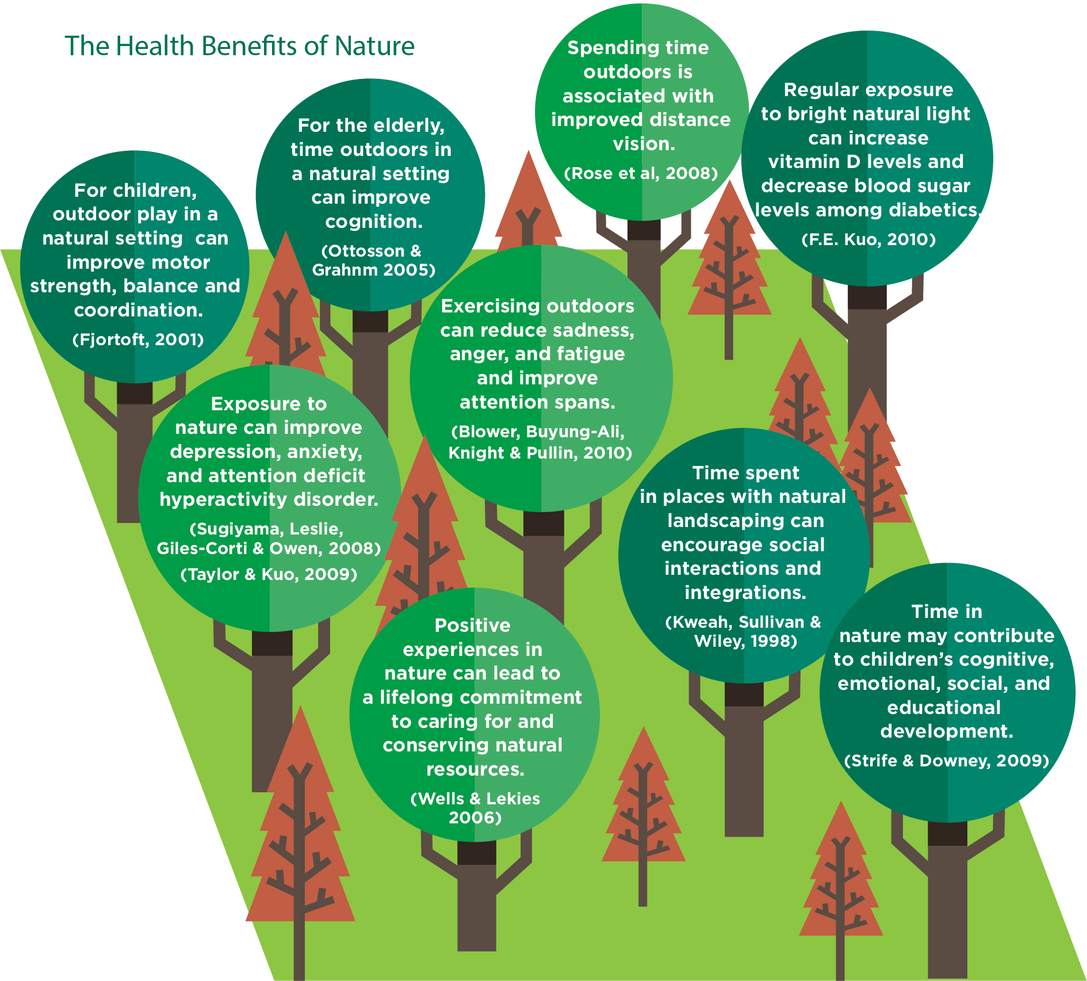

Slide 11
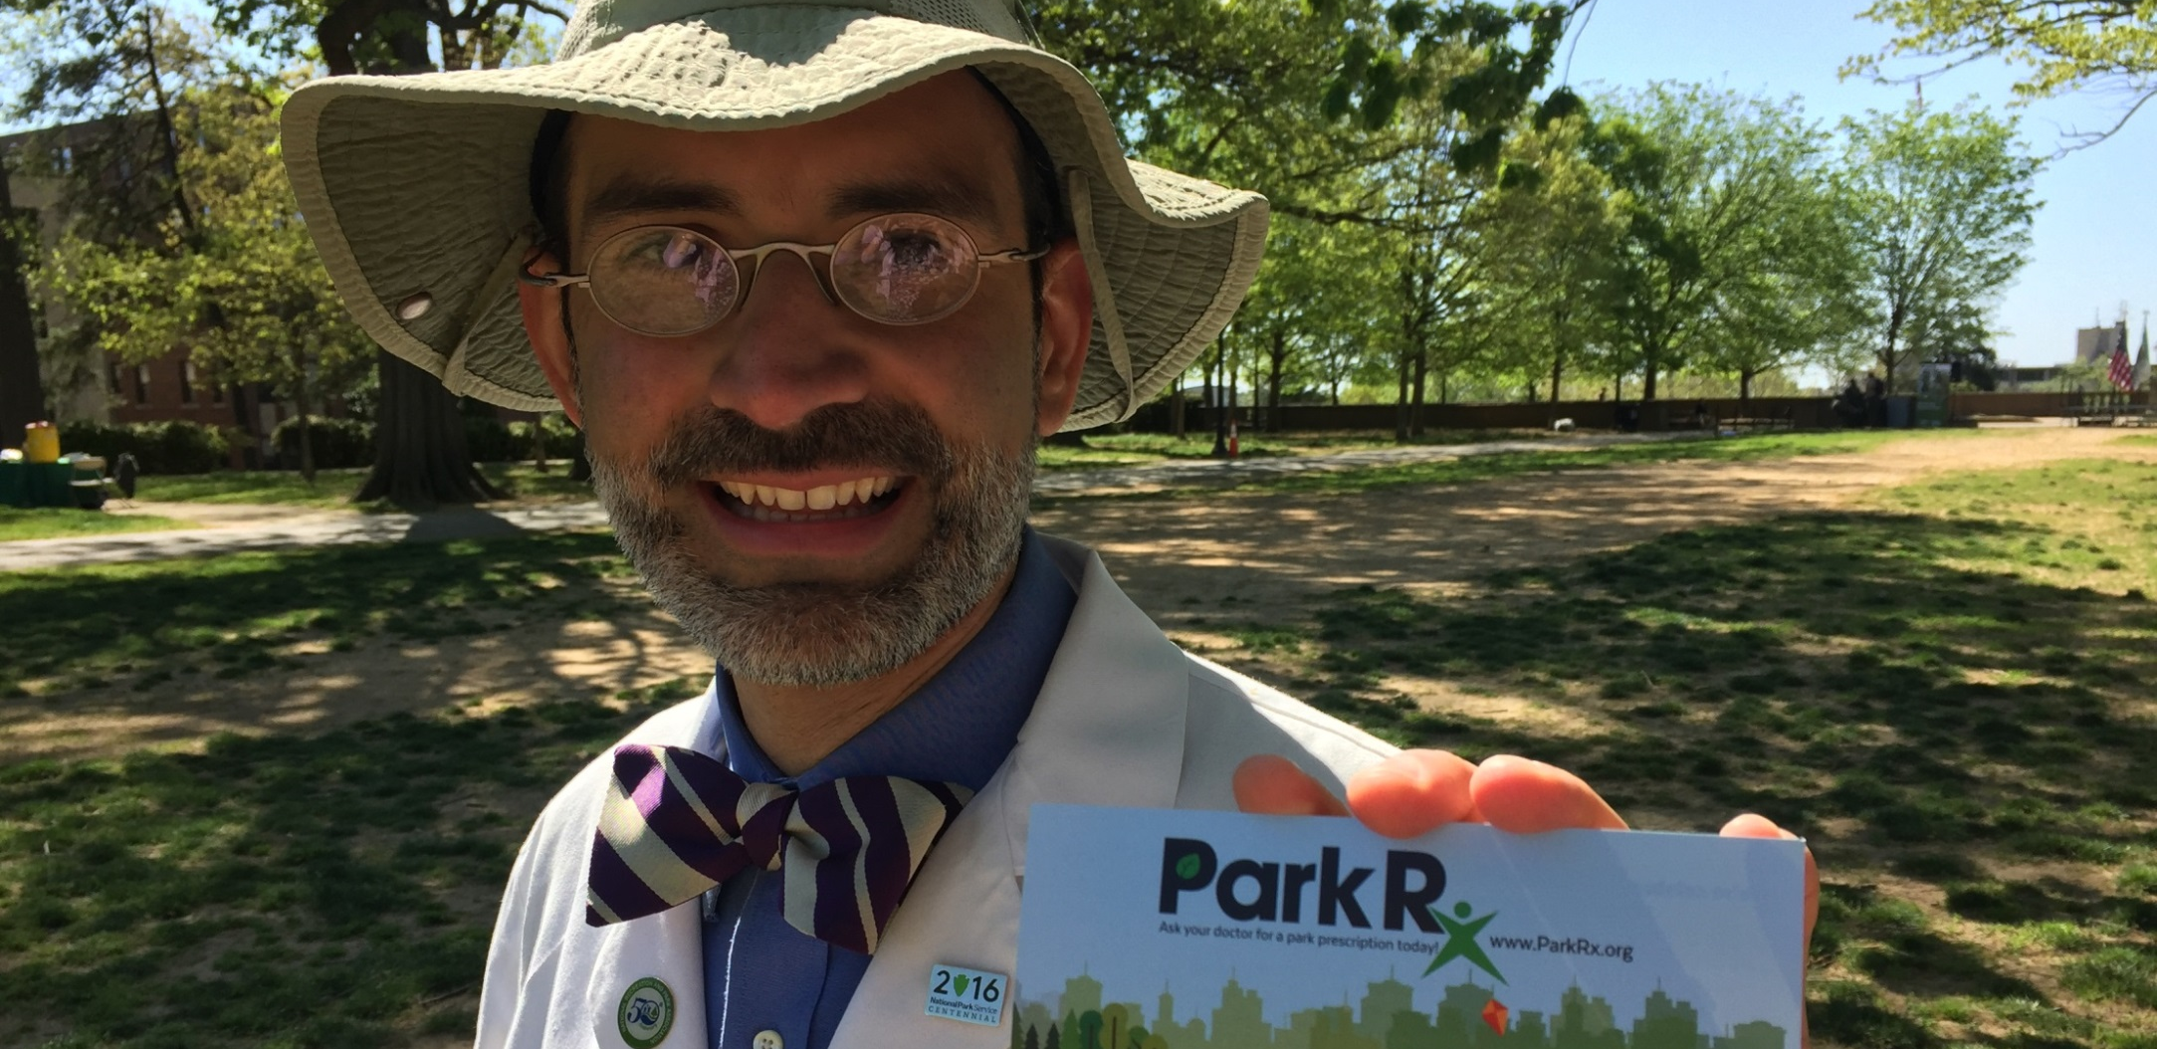
What do we do about it?
Park Prescription Programs are designed in collaboration with healthcare providers and community partners and utilize parks, trails, and open space to improve individual and community health.
Notes:
Photo credit: Donna?
And this is where Park Prescriptions come into play… Park Prescriptions are programs designed in collaboration with healthcare providers and community partners that utilize parks, trails, and open space to improve individual and community health.

Slide 12
Park Prescription Programs
New Park Stewards
Health programs in parks
Park & nature programs in health systems
Parks are valued as integral to healthy, active communities by all
Behavior Change
Better Community Health
Notes:
So we have the healthcare providers that are already serving our target populations and are looking for more resources for these populations, and we have the park agencies that have the resources to serve these communities and are looking to attract new park users. Park Prescription programs take these two stakeholder groups, brings them together to create a partnership that helps the agencies reach their own goals and, most importantly, provides a much needed health resource to vulnerable populations that need it the most.
One note on language, although I am using the term “park,” I want to encourage you to think of any open-to-the-public natural land, including open space preserves, areas within land trusts, or other public land entities. Additionally, when I use the term “park agencies,” I am referring to any organization that maintains greenspace and provides recreation, either through staff or docents.
At their best, Park Prescription programs:
Promote behavior change to increase healthy lifestyles among vulnerable populations
Improve individual and community health
Create new stewards and advocates for parks and public lands

Slide 13
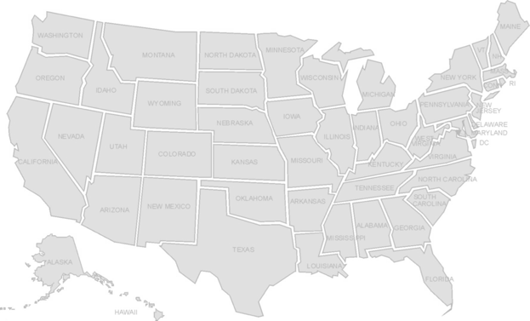
Park Prescription Programs
N = 37
Clinic based
Park based
Does not include the extensive locations from NEEF; Walk With a Doc; Exercise is Medicine
Community based
Health plan
Notes:
The concept of Park Prescriptions is something that really only started taking shape about 5 years ago and in that time we’ve seen an explosion of programs across the United States. The National ParkRx Initiative, with the support of the National Recreation and Parks Association, has been tracking the growth of these programs. There are currently 37 Park Prescription programs, that create this clinic to park connection.
In addition to these programs, there are hundreds of individual health & nature champions across the country through the National Environmental Education Foundation’s Nature Champion program, Walk with a Doc, and Exercise is Medicine.
Even when we look at the Park Prescription programs, as we would define them and that include both health and park partners, the models and how they’re implemented vary significantly across programs. Some are really driven by the parks and others by the health provider and some are an equal partnership.
And for the rest of my time today, I want to focus on this equal partnership model. This is the model that we’re implementing in the Bay Area and the model that we see as really exciting and having the potential for systems change.

Slide 14
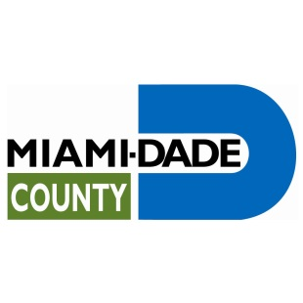
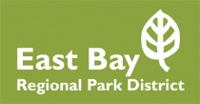
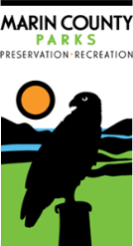
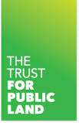
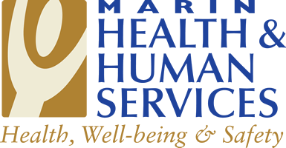
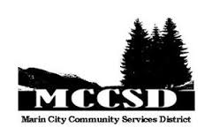
Park Prescription Models
Marin City
Miami Dade
Oakland
Notes:
I want to share a few case studies of some of the Park Prescription programs that have developed a really robust partnership, a cohesive clinic-to-park process, and are starting to show exciting results.
The Marin City Park Prescription program started in 2014 and includes numerous partners from both health and park sectors, with Marin Health and Human Services playing the backbone coordinating role. This initiative started with a pilot program in Marin City, the community in Marin with the highest poverty rates and lowest life expectancy, and it’s focus was low-income, African Americans. It is now being expanded to other communities across Marin County.
The Miami Dade ParkRx program started 5 years ago and has been a partnership between Miami Dade Parks, Rec, and Open Space, the University of Miami, Baptist Health. This program targets obese and overweight children and connects youth from the health system to a year long, evidence-based, park-run after school program.
In Oakland, EBRPD and UCSF Benioff Children’s Hospital have been partnering to develop a program that they call SHINE – Staying Healthy in Nature Everyday. This programs aims to reduce stress for low-income youth and their families through an urban Federally Qualified Health Center. It provides at-risk families with resources to understand and take advantage of the health benefits of nature.

Slide 15
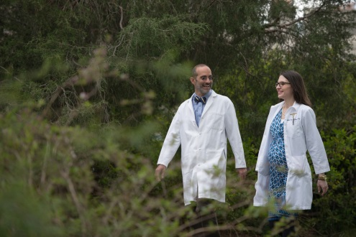
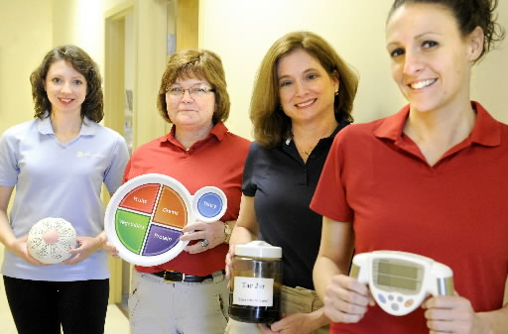
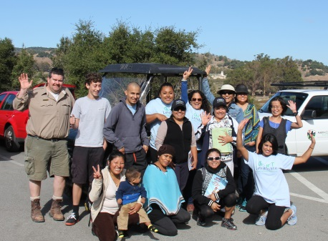
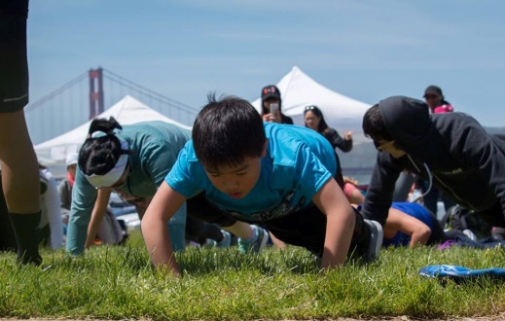
Park Prescription Programs in Action
Patient Visit
Health care providers assess if patient would benefit from time in nature
Enter Park Prescription in the electronic medical record system
Electronic medical record signals health educators to contact the client
Health educators provide support for client to attend park program
Marin City
Patient participates in guided, tailored park programs
Collect data on biometric and behavior changes
Miami Dade
Oakland
Notes:
Photo credit (#4): Ryan Curran White, Parks Conservancy
These three programs follow a very similar process. They start with a patient visit to a healthcare facility where the provider assesses the patients’ needs and determines if the patient would benefit from time in nature. The provider then enters the park prescription into the electronic medical record and provides the patient with basic information on how to fill the park prescription. Often this is in the form of maps, program information, or other collateral.
The entry of the park prescription into the EMR sets off a trigger within the system and sends a message to a health educator, who then reaches out to the patient to provide counseling and/or support in identifying and participating in a specific, relevant park program.
The patient then attends a park program that has been designed to meet their specific needs and help overcome barriers to park access. These programs can range from regular after-school programs, to weekend nature walks, Zumba, or tai chi classes.
The health educator continues to follow up with the participant, collecting data on biometric and behavior changes, tracking to see if the participant continues to attend parks/park programs, and reporting back to the healthcare provider.

Slide 16
Common Program Elements
Planning
Robust partnership and commitment
Clearly identified target audience and health outcomes
Designed to overcome target audience barriers
Implementation
Prescriptions entered through EMR
Clinic-park navigators/health educators
Park programs prescribed
Aligned messaging reflected across many sectors
Notes:
There are strong commitments from all levels across partner organizations. In general, these programs also have one organization that acts as the backbone convener, making sure there is ongoing, regular communications and ensuring that the partners are able to troubleshoot and communicate as any issues arise
The programs all have a clear target audience and health outcomes they’re seeking to address.
They have also invested time and resources into understanding the barriers that their audience faces and have designed their programs to overcome those barriers – whether that be through providing transportation, eliminating program fees, or ensuring the park staff are trained to provide a warm welcome
The prescriptions are designed to work with existing electronic medical record systems and to be as seamless and easy as possible to implement on the provider side, one element that providers have indicated as critical is the ability to give prescriptions quickly and in the course of their usual work, so integrating it into existing systems that allow providers to easily track the prescriptions has been very important
All three programs have staff designated to help patients navigate from the clinic to the park – they are called different things (health educators, wellness specialists, promotores) but they all have one-on-one contact with the patient to encourage them and support them in attending park programs
Something common across these programs, though not necessarily all ParkRx programs, is that they are prescribing actual park programs – not just unstructured time in nature; a recent survey of public health practitioners in SF found that if healthcare providers know of a specific location and activity in nature, and are confident that their low-income patients would be welcome, they were more likely to recommend a park visit
And finally these programs integrate health and nature messaging across many sectors – nature and park messaging and collateral is integrated into the clinic setting and health messaging is integrated into the park programs

Slide 17
Program Differences
Target audiences and health outcomes
Location of Health Educators
Resources provided to patients
Different levels of client interaction
Range of park programs
Geographic scale
Notes:
At the same time, each of these programs is unique and has elements tailored to meet their specific circumstances. It is critical to determine how to adapt the program to fit the specific partners and the specific audiences you want to reach.
Each program had a different, yet well-identified, target audience; from obese youth to low-income African American families, the partners in the different programs spent time early on clearly identifying their target audiences. At the same time, they also identified different health outcomes they were targeting. As we discussed earlier, nature provides numerous health benefits and it is important to know if there are particular outcomes you seek to influence, as that can help guide specific programs.
The health educator positions also varied across programs depending on organizational capacity and focus. In Miami the educators were provided by the park agency, in Marin City and Oakland they are employed by the health partner.
The next three program differences all reflect how programs are tailored to meet the needs of their respective audiences. For example, in Oakland access was identified as a critical barrier so the program found funding to provide shuttles from the hospital to the park program. In Marin City, they identified that their patients needed a high level of interaction with the health educator, so the educators actually would attend park programs with the patients and check in with them at multiple points. And in all cases the park programs were tailored to meet the needs and health outcomes identified by the program partners.
And finally, the scale of these programs varied widely, both in geography and in number of partners. Marin City program involved a number of partners but focused on one rather small community. The Miami Dade program includes 35 different park sites across the county.

Slide 18
Program Impact
Miami Dade
Decrease in Body Mass Index
Decrease in blood pressure
Decrease in hypertension
Improvement in Presidential Fitness Test scores
Increase in knowledge of healthy behaviors
Messiah (2016)
Notes:
In Miami, they’ve been collecting data for the past five years and have consistently seen year-after-year impacts for their intervention. Amongst their clinically obese and overweight participants they’ve seen consistent…

Slide 19
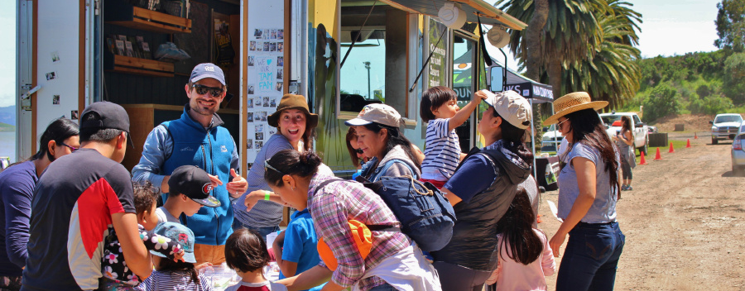
Program Impact
Marin City (early results)
Decrease in BMI
Decrease in blood pressure
Decrease in feelings of depression
Mercer Slomoff (2016)
Notes:
***This isn’t a Conservancy photo. I don’t think we can use it. Sue Gardner had posted it on Yammer and said “at Park Prescription (HPHP) Day at both Marin City and McNears Beach. Before posting these on external media, I need to make sure I have all the permissions.” She never followed up on Yammer about permission.
In Marin City, they have just started collecting biometric data on their participants in the past year and currently only have some very preliminary results. However these early outcomes show positive improvements in…

Slide 20
Program Impact
Oakland
Conducted randomized trial offering one group staff-led programs and the other visited parks independently
Both groups experienced decreases in stress and continued to visit the parks in even greater “doses” than originally prescribed
The group that participated in staff-led programs experienced a greater decrease in feelings of loneliness
Razani (2016)
Notes:
In Oakland, Dr. Nooshin Razani has been leading some really interesting studies comparing different program models. They conducted a randomized trial where the control group was just given a recommendation by the pediatrician and written resources on parks while the second group was also provided with a case manager and was invited to come on outings with transportation and lunch provided.
The results showed that both groups experienced greater decreases in stress and they continued to visit parks in ever greater “doses” than was originally prescribed – showing that even without the additional staff support, the prescription made a positive impact. However, the group that was given transportation and participated in a staff-led program also reported greater decreases in feelings of isolation and loneliness than did the group that had self-led park experiences.

Slide 21
Program Impact
“You inspired me to begin walking, to finally do what my doctor has been wanting me to do for years. I have lost almost 50 pounds… I have a new respect for parks and LOVE getting on walking trails.” - San Francisco Participant
“Although I only recently started the ParkRx program, in the last two weeks I have practiced healthier nutritional habits and I have been moving more and more. It really helps to check in with someone so kind, inspiring, and knowledgeable.”
- Marin City Participant
McHenry (2016); Mercer-Slomoff (2016)
Notes:
So what we’ve seen in these case studies, and what we’re seeing as more and more research comes out from these programs, is multiple benefits across partners and participants. Healthcare providers are seeing improved health outcomes for their patients. Park agencies are reaching audiences that have been traditionally underserved, building new park users and advocates. And individuals and communities are having amazing experiences, building connections with their local parks, and improving their mental, physical, and emotional health.

Slide 22
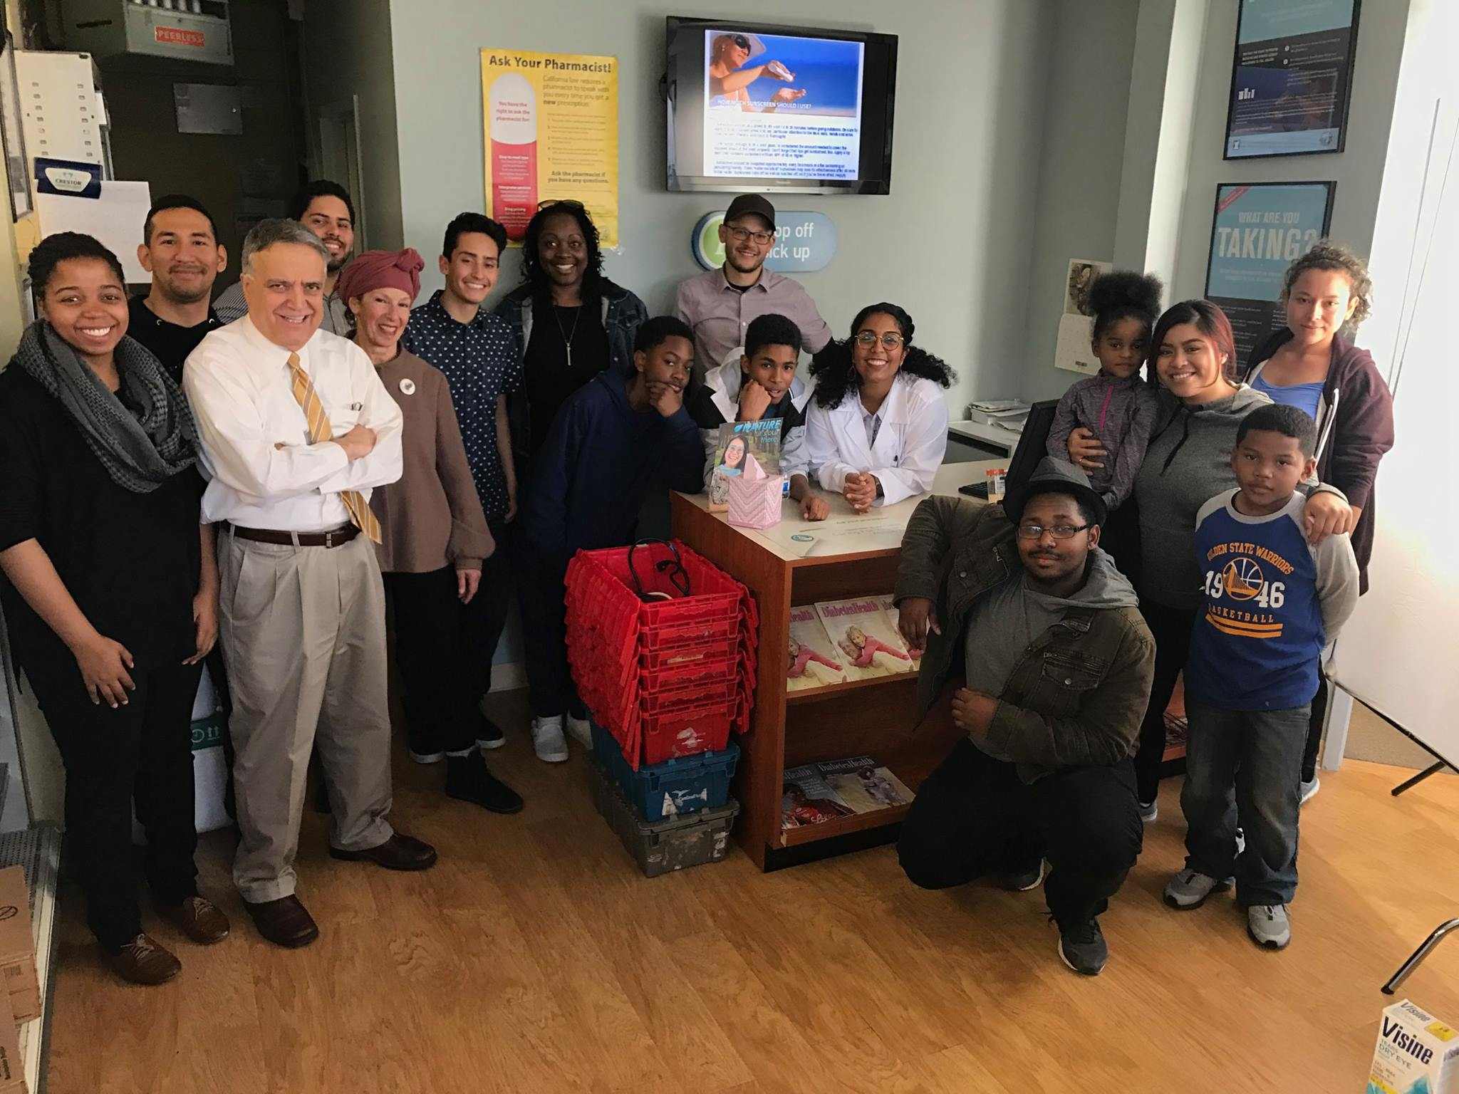
Marketing Video
https://www.youtube.com/channel/UCBVyef6Ym1qeBktWa1AyE1w
Notes:
Photo credit: BAYCAT?
Before we jump into Q&A I wanted to share one recent marketing piece that was developed for Park Prescriptions. A big part of all Park Prescription program is the outreach – and I thought it would be appropriate to close with this video that I find particularly inspiring and that I think captures the essence of Park Prescriptions better in 2 minutes that I have in the past 25.

Slide 23
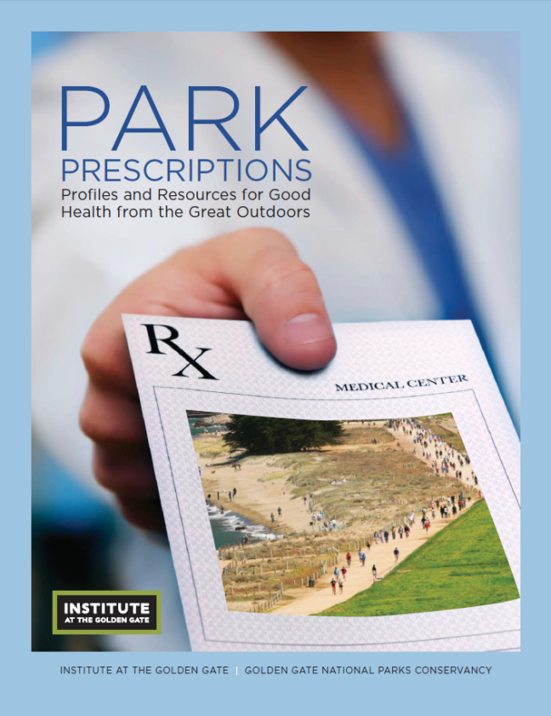
Resources
www.parkrx.org
www.hphpbayarea.org/parkrx
www.instituteatgoldengate.org/health
Notes:
So, I’m getting to the end of my time but the Institute at the Golden Gate has put together a range of resources on Park Prescriptions, which can be found at the above websites.

Slide 24
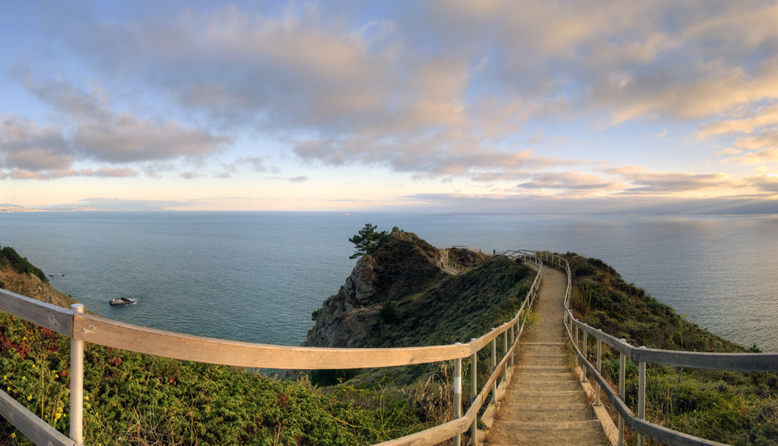
Thank you and see you in the parks!
Notes:
Photo credit: Parks Conservancy

